Slide 1

SGX
security & performance evaluation
Tõnis Lusmägi
School of Information Technologies / Department of Computer Systems
Tallinn University of Technology
6.6.2019

Slide 2
outline
Problems
  SGX Security Review
  SGX Setup
  SGX Performance Benchmarking
Motivations
  Break SGX
  Improve SGX
  Share findings
2
Notes:
Research Objects

Slide 3


What is sgx?
SGX - Secure Guard Extensions
  2 Keys in CPU’s eFuses
  3 instructions containing 30 leaf functions
    SGX1
    SGX2
    OVERSUB
  Software Stack
    SGX SDK
    SGX PSW
    SGX Driver
    Eclipse Plugin
SGX can be applied to regular desktop applications or embedded
SGX encrypted memory region - Enclave
Hardware-based encryption
Skylake
6th gen
3
Notes:
SGX is, consists of and offers
PSW is services (AESMD)
SDK is libs, debugger, etc
Driver – kernel module

Slide 4
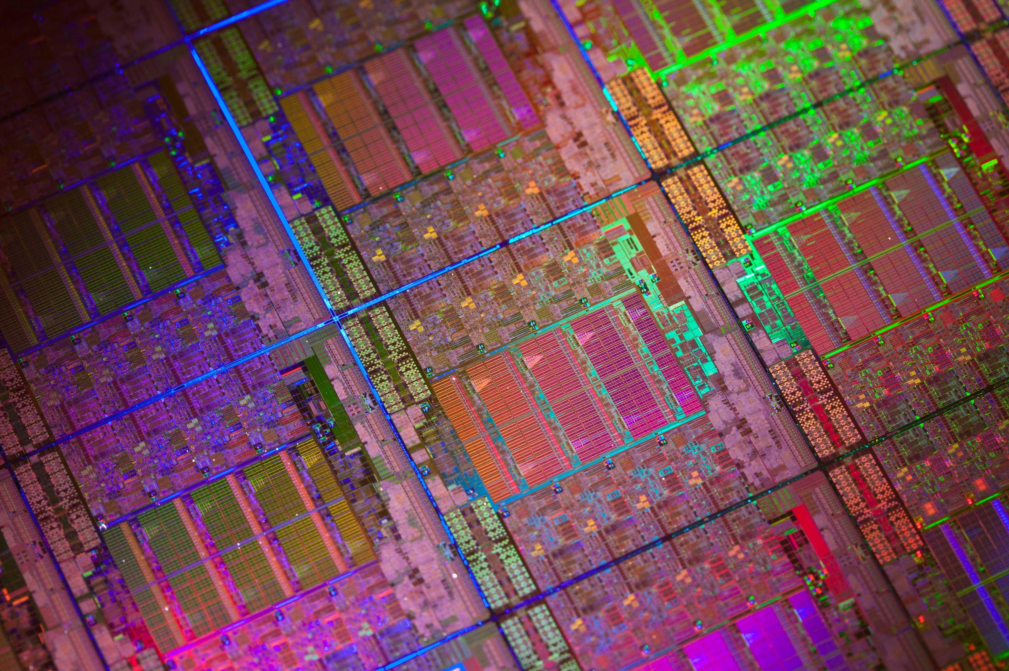

SGX
Security
Notes:
https://icdn3.digitaltrends.com/image/intel-xeon-silicon.jpg

Slide 5

SGX Structure from hardware level to system level
EPC - Enclave Page Cache
EPC pages have 4 KB granularity
EPC up to 128 MB in size
5
Notes:
EPC – Virtual Address Space of the Encrypted Memory Area

Slide 6
SGX security model
SGX enclave memory cannot be read or written from outside the enclave regardless of privilege level and CPU mode.
This shields the enclave from the OS, SMM and VMM, or another enclave.
Protection against software and hardware attacks
NO security guarantees against side channel attacks or reverse engineering!
6
Notes:
CPU mode is 32bit or 64bit
IA-32 Architecture protection mechanism

Slide 7
SGX literature review
Side Channels
Return-Oriented Programming (ROP)
Speculative Execution Side Channels
Controlled-Channel Attacks: Page Faults
AsyncShock
Software Grand Exposure
T-SGX mitigation
CacheZoom
Cache Attacks on Intel SGX
Branch Shadowing
High-Resolution Side Channels
Malware Guard Extension
Stacco
Foreshadow
Foreshadow-NG
Practical Enclave Malware
RIDL (Rogue In-Flight Data Load)
Hacking in Darkness: ROP
Telling secrets without Page Faults
TSX mitigation: Cloak
7
Notes:
Microarchitectural Data Sampling (MDS)

Slide 8



Speculative execution attacks
8

Slide 9

System
Setup
Notes:
https://capsule8.com/wp-content/uploads/2019/02/linux-hardening.png

Slide 10

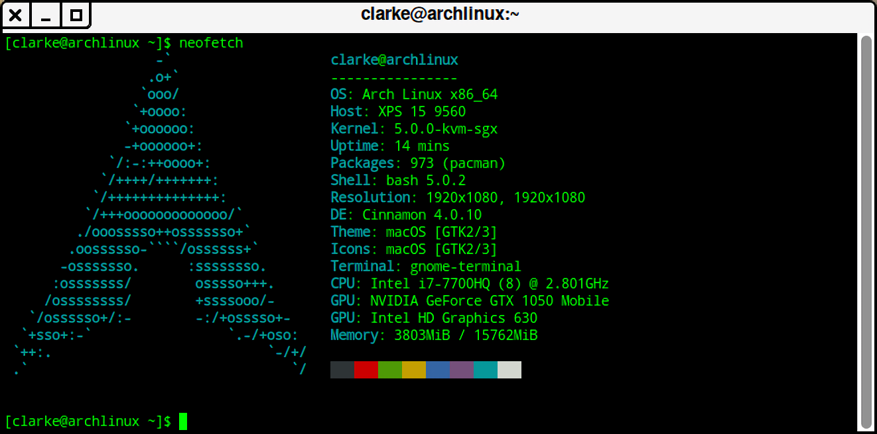
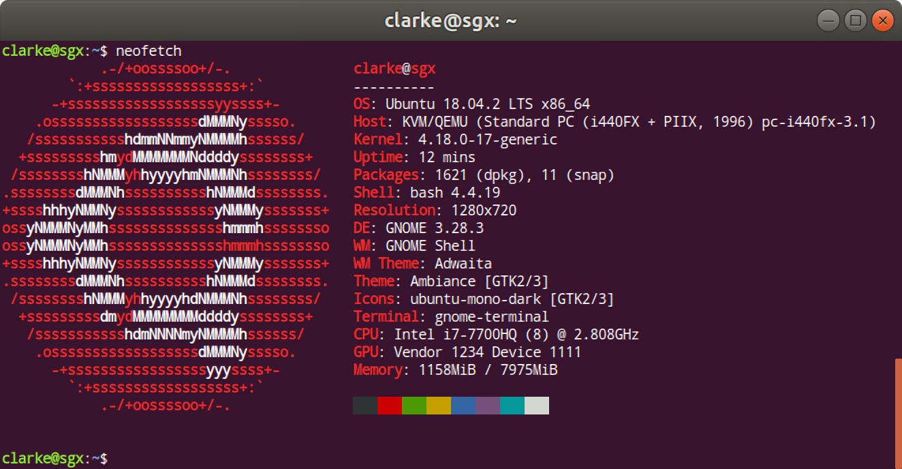
hardware and operating systems
For benchmarking
10
Notes:
https://www.francescospighi.com/dell-xps-15-2017-review/2017/02/

Slide 11

SGX
performance
Notes:
https://icdn2.digitaltrends.com/image/intel-10th-gen.jpg

Slide 12
Testing Specifications
Identified Edge Routine Methods
  Regular Calls
  HotCalls
  Switchless Calls
Hypothesis
  Host System outperforms Guest System, Switchless Calls outperform HotCalls.
Testing Methodology
  Based on “Regaining Lost Cycles with HotCalls: A Faster Interface for SGX Secure Enclaves” – O. Weisse, V. Bertacco, T. Austin & Intel’s Switchless Example
  CLFLUSH(), RDTSCP() – similar to FLUSH+RELOAD
  6.4M measurements
  Cold Cache CDF graphs, Median Results, 99th Percentile
12
GitHub.com/SGX-Performance
Notes:
CDF – Cumulative Distribution Function

Slide 13
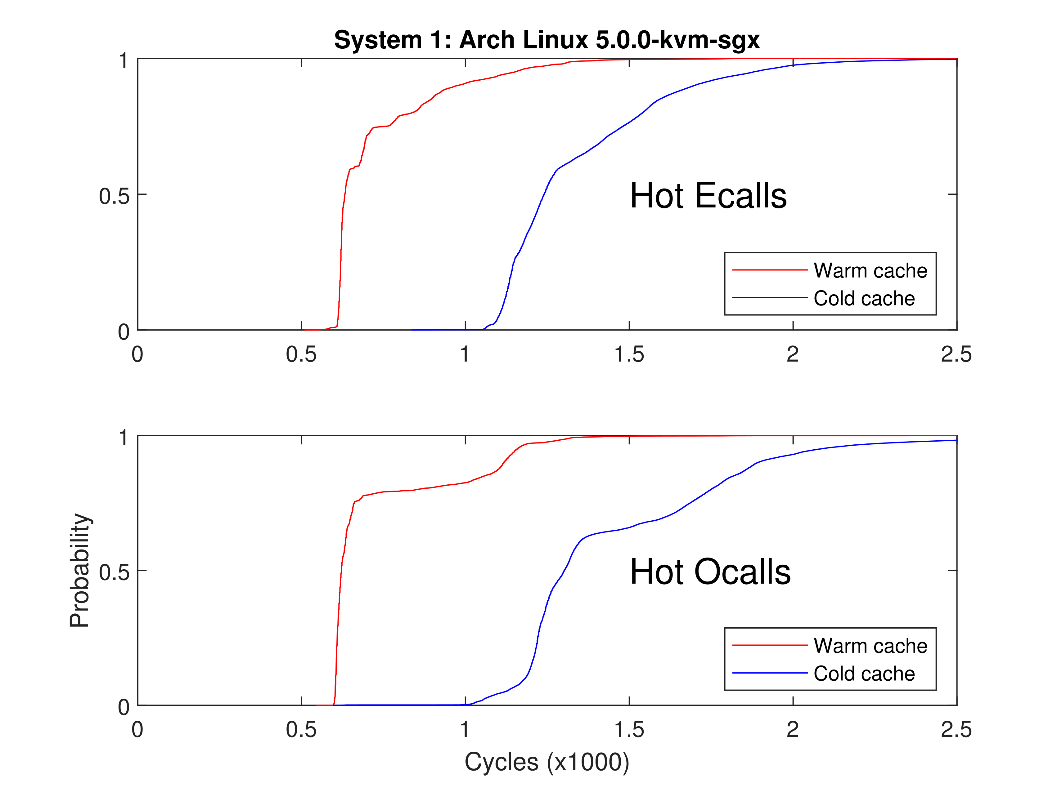
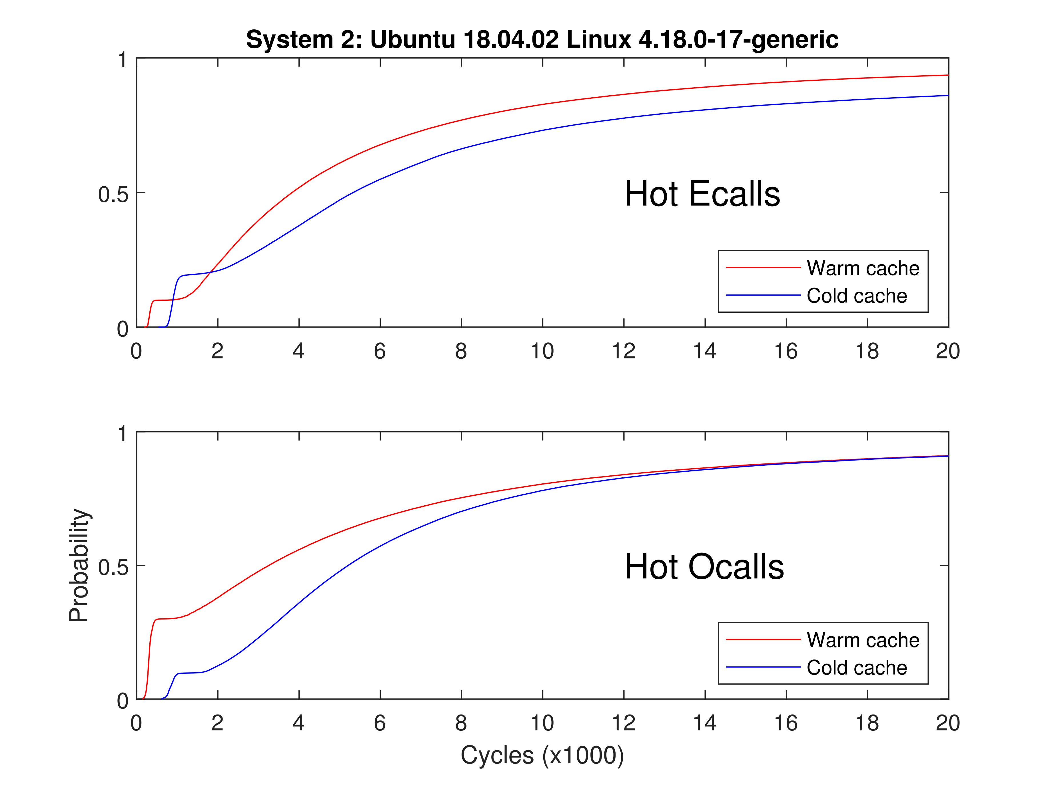
Example Cdf
Undefined behavior !!!
13

Slide 14
Microbenchmark results generalized
Hypothesis: Host System outperforms Guest System, Switchless Calls outperform HotCalls
Host System Generally Faster by 1.2X
HotCalls 12X faster than Regular Calls
Switchless Calls 10X faster than Regular Calls
System Calls 100X faster than Regular Calls
ANOMALY ! DISCOVERY?
Hypothesis: Not Confirmed!
14

Slide 15

SGX
summary

Slide 16
SGX Research summary
Current Research Concludes
  SGX Amplifies Side Channel Attacks
  Quantum resistant cryptography primitives NOW!
  Regular SGX Calls cause a performance degradation of 88-105X compared to System Calls!
  Performance degradation is reduced to 10X by using Switchless Calls.
Significance
  Performance benchmarking uncovered a potential scientific discovery! Accidental FLUSH+RELOAD!
Future research
  Examine if discovery matches with RIDL’s (MDS) fingerprint
    Preliminary research shows YES!
  SGX Virtualization Research
16

Slide 17
SGX
security & performance evaluation
Tõnis Lusmägi
School of Information Technologies / Department of Computer Systems
Tallinn University of Technology
6.6.2019

Slide 18
Sgx Implications and features
Rules and limitations
  Native C/C++
  Calls to OS and SO through SGX edge routines
  Synchronization using SGX SDK libraries
  Limited threading support
  Dynamic memory allocation
  Static linking of libraries
Features at a glance
  Attestation
  Sealing
  Switchless calls
  Key Sharing & Separation
Notes:
Dyn mem alloc. – Max heap size set at enclave creation
SO – shared Object

Slide 19
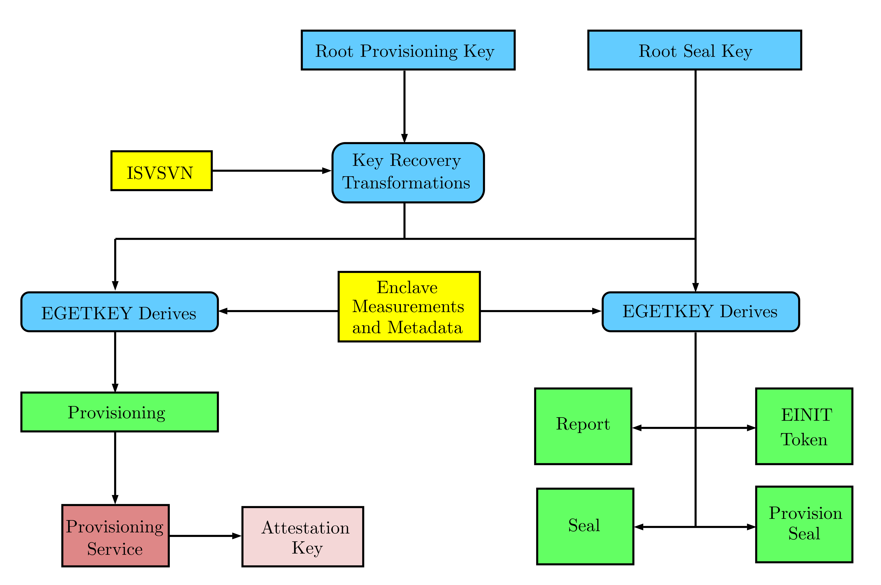
SGX Key hierarchy
Intel knows
CPU knows
Key transformation
  Hardware level
  Software level
Key derivation
  Enclave requests key
Notes:
Software Vendor Security Version Number (ISVSVN)

Slide 20
SGX Encryption schemes and primitives + Hash
Symmetric
  AES-CTR – Advanced Encryption Standard – Counter
  AES-GCM – Advanced Encryption Standard – Galois/Counter Mode
  CMAC – Cipher-based Message Authentication Code
  HMAC – Hash-based Message Authentication Code
Asymmetric
  ECC – Elliptic-Curve Cryptography
  ECC-ECDSA – Elliptic-Curve Cryptography – Elliptic Curve Digital Signature Algorithm
  RSA-PKCS#1 v1.5 – Rivest–Shamir–Adleman – Public-Key Cryptography Standards
  SHA-1 – Secure Hash Algorithm – 1
  SHA-2 – Secure Hash Algorithm – 2

Slide 21
Setting up SGX systems for benchmarking
SGX inside CPU
  Core
  Xeon
  Pentium
  Celeron
SGX must be enabled in the firmware (UEFI)
Building & Installing SGX software stack
  SGX SDK
  SGX PSW
  SGX Driver
  SGX Eclipse Plugin
SGX Virtualization – Experimental Software !!!

Slide 22
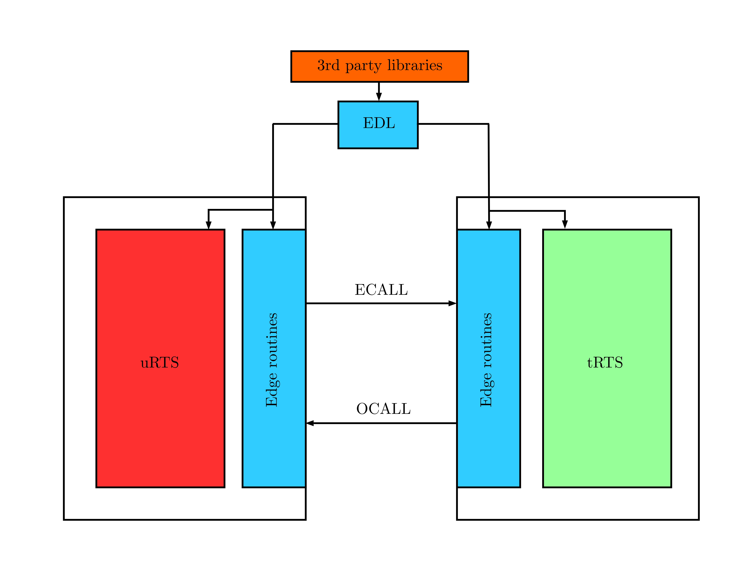
SGX hypothetical generic Run-time system
Untrusted Run-Time System (uRTS)
Trusted Run-Time System (tRTS)
Edge Routines
3rd Party Libraries
EDL proxy file
Describes a typical SGX program
5

Slide 23
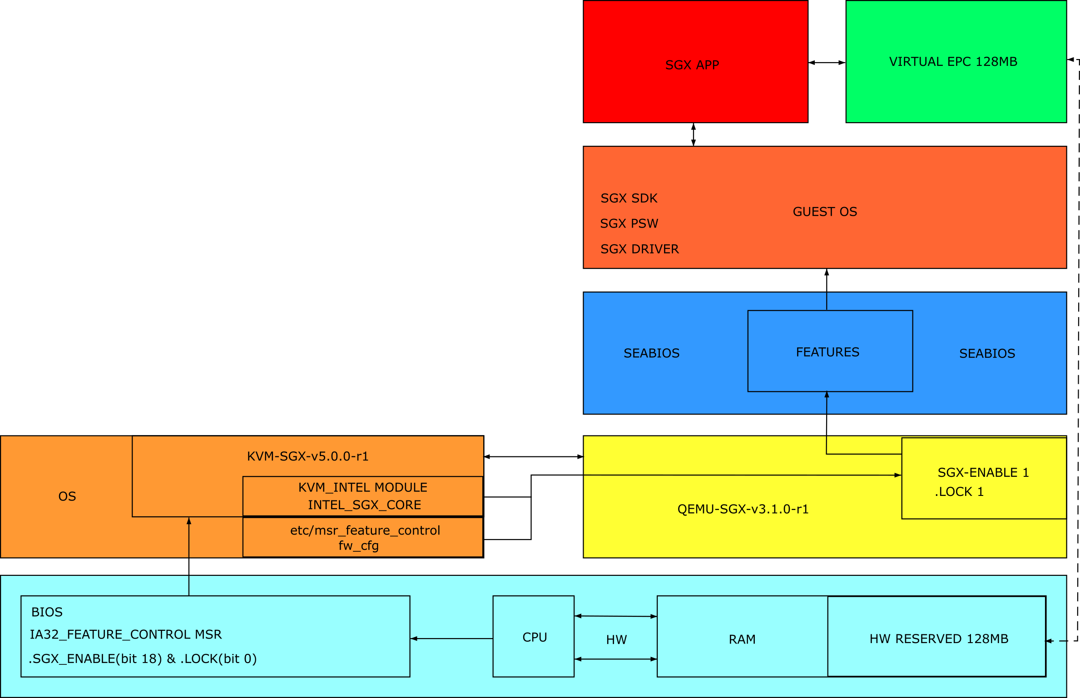
SGX VIRTUALIZATION using KVM-SGX & QEMU-SGX

Slide 24
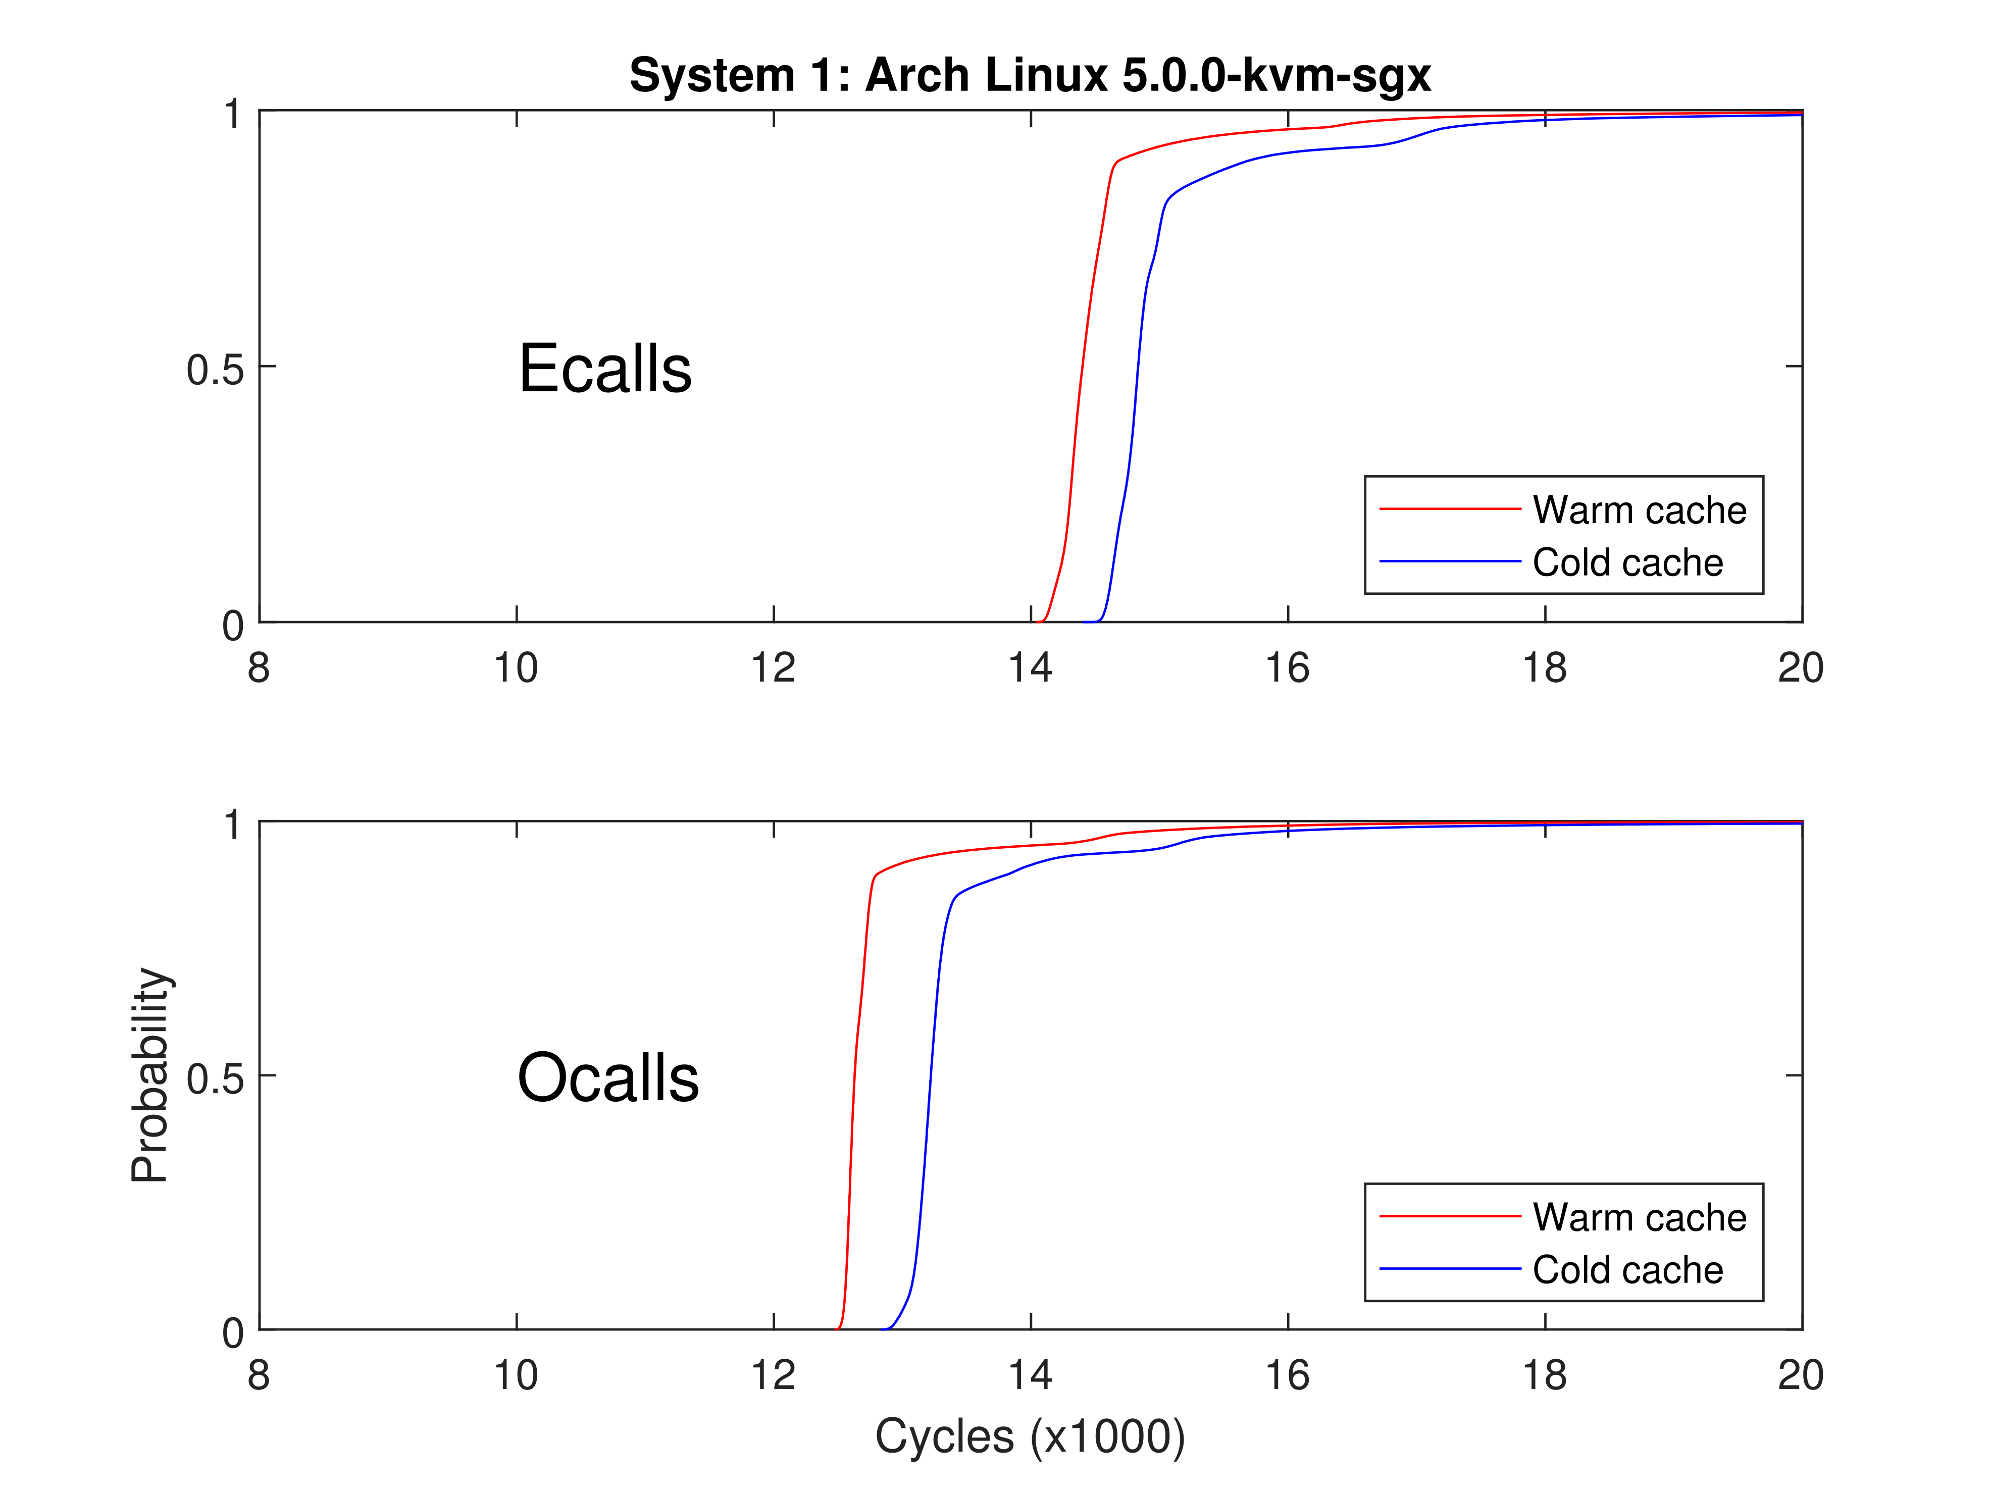
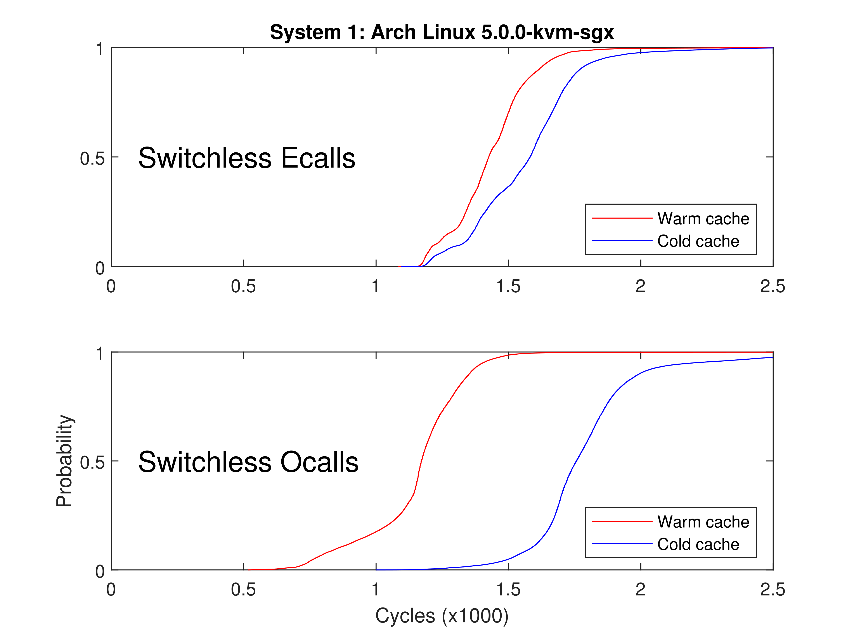
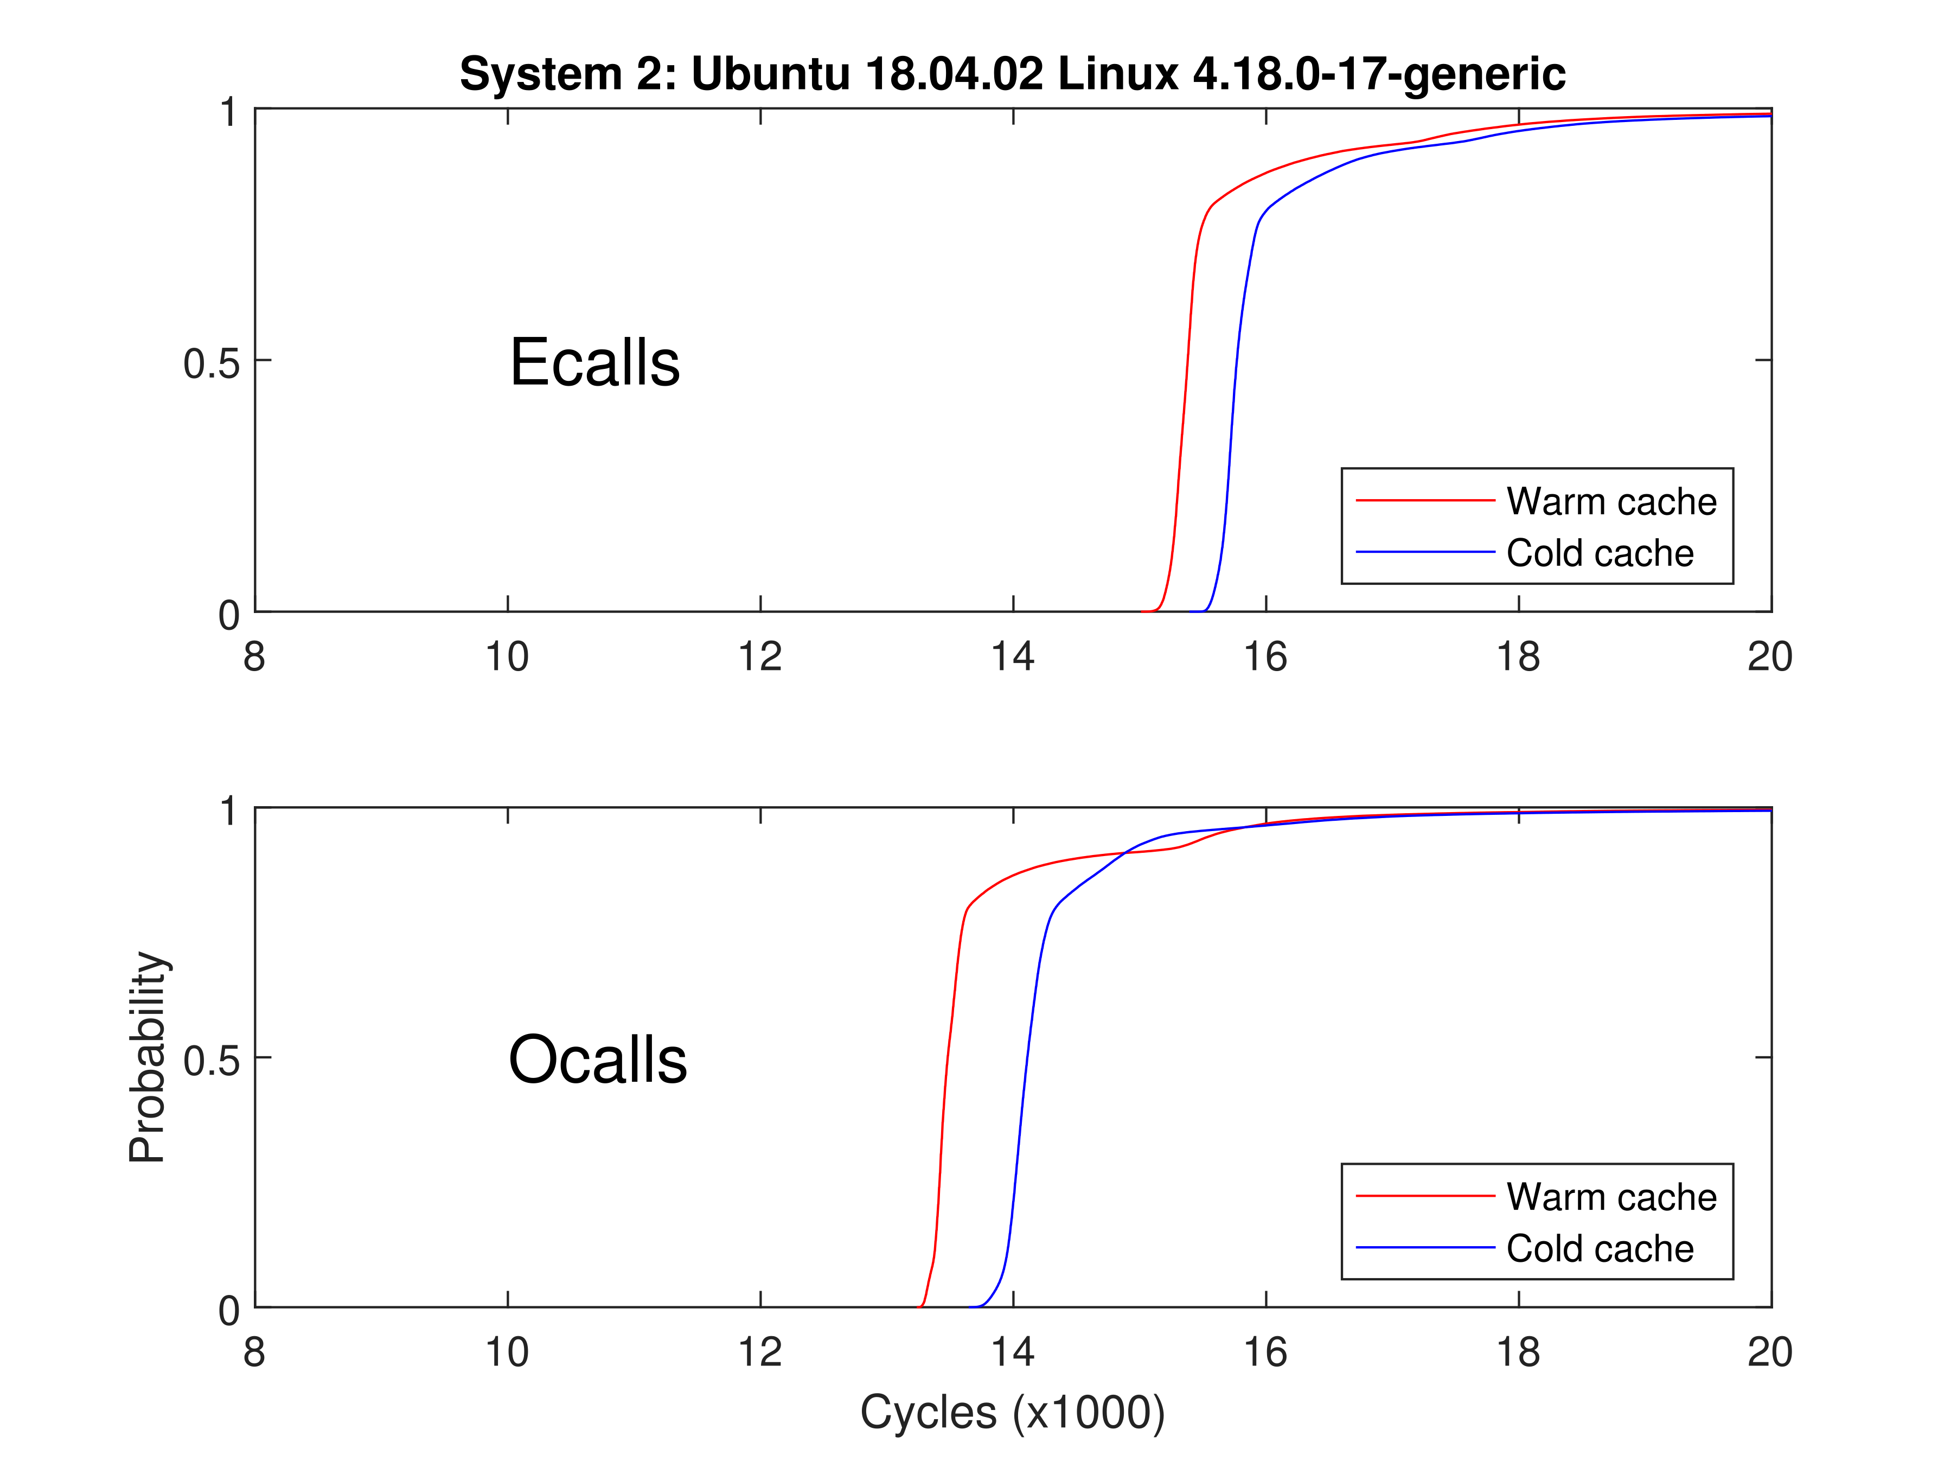
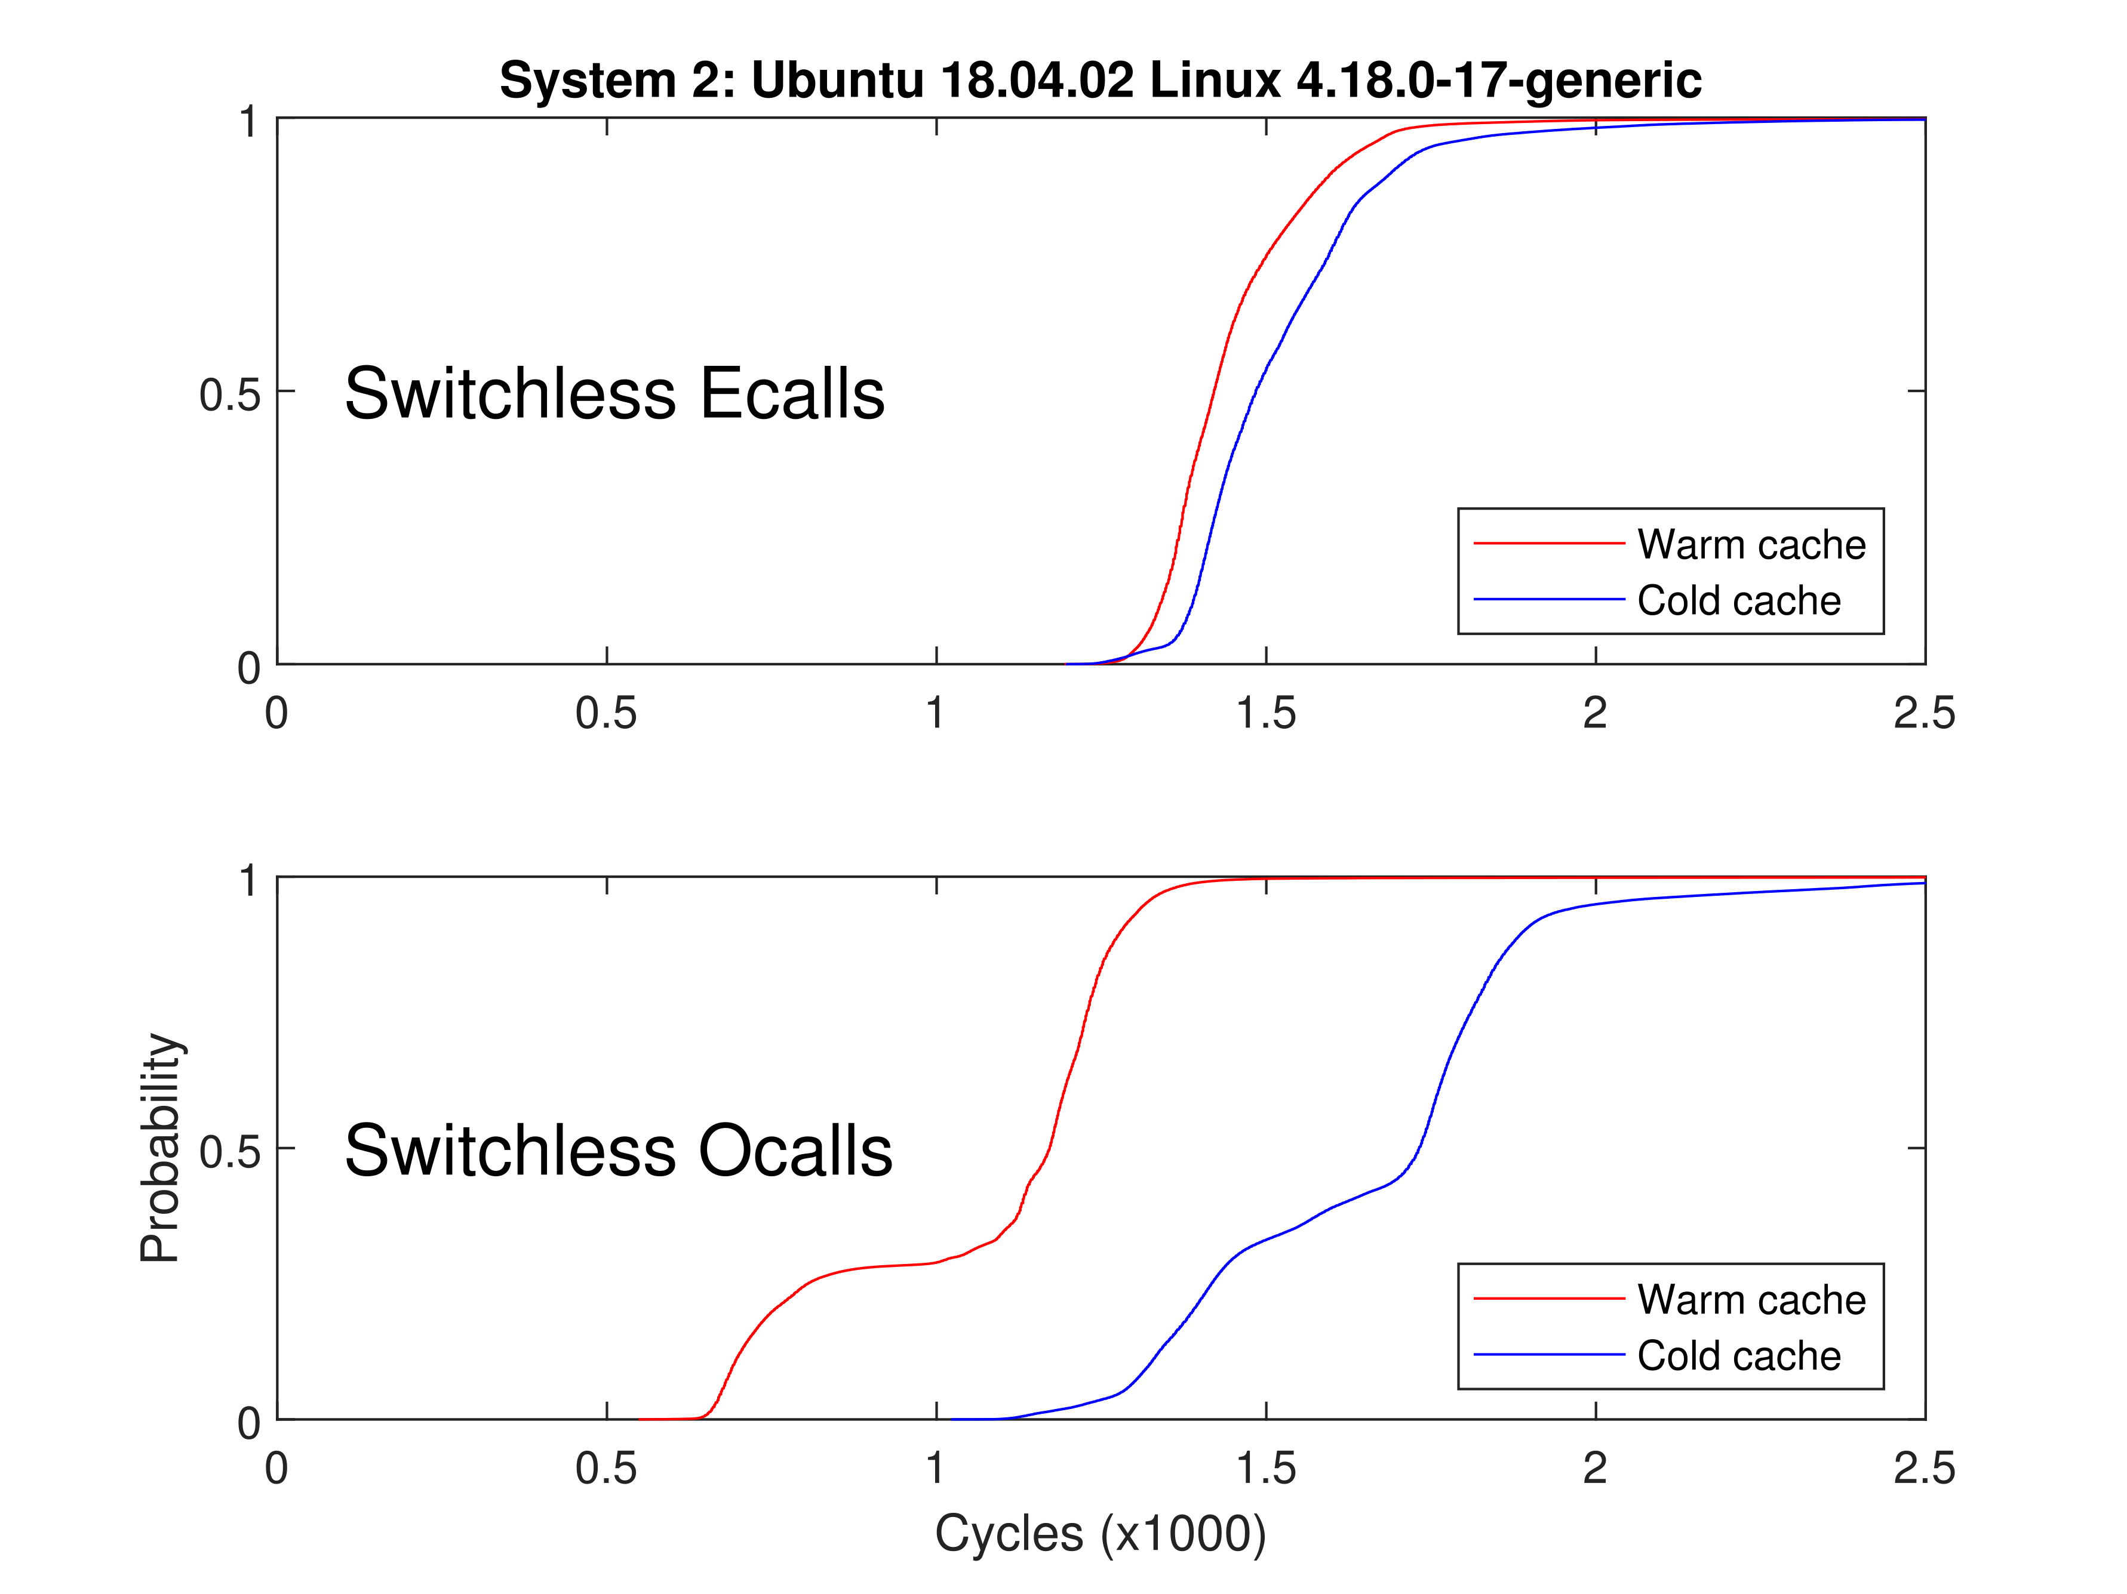

Slide 25
SGX Research summary
My Research Conclusion
  Side Channels Amplify SGX Attacks
  Quantum/proof cryptography NOW
  Speculative execution vulnerabilities calling for a new architecture
  ROP is practical and dangerous
  SGX Virtualization is Hot
  Scientific Discovery
Significance
  RIDL
Future research
  Possibly New Exploit Stemming from Current Work
  SGX Virtualization Research

Slide 26


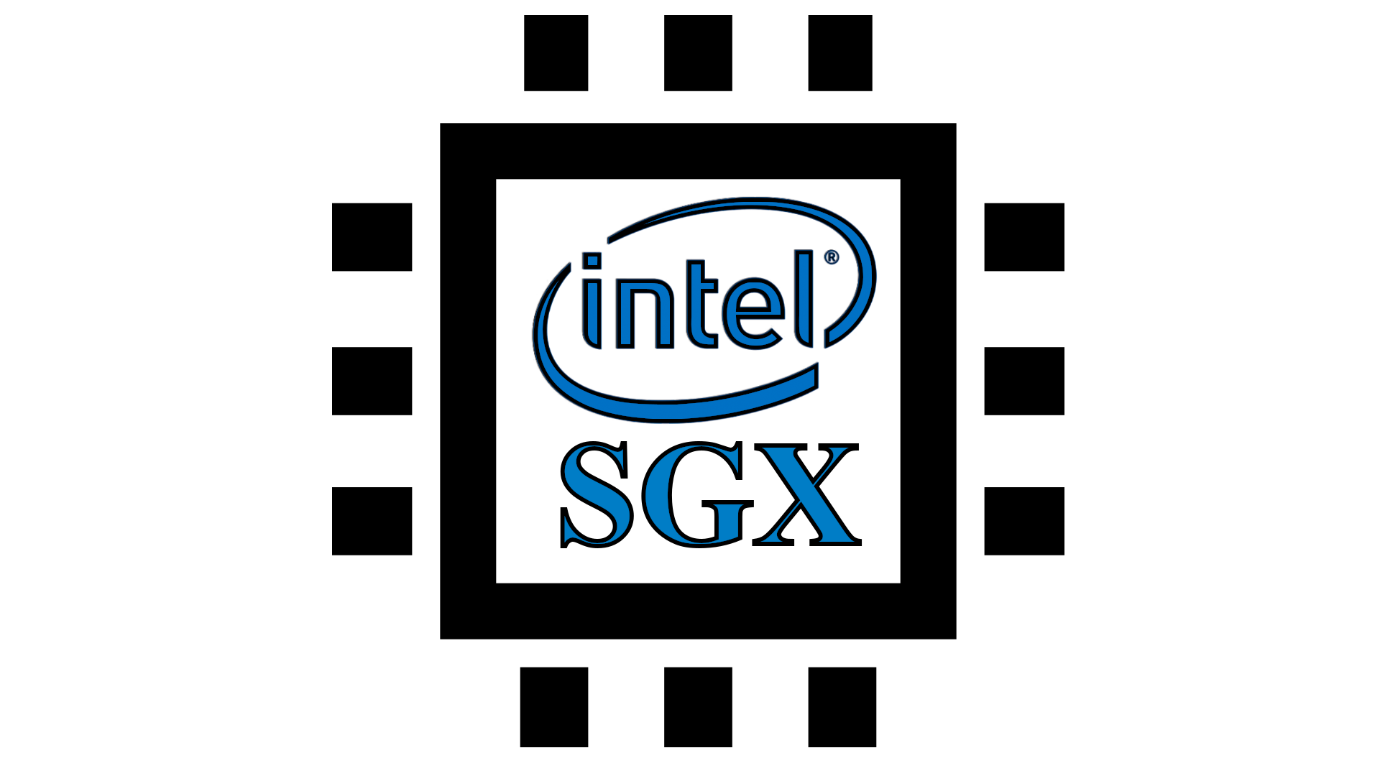

Evolving into SGX

